Slide 1
PHISHING DETECTION SYSTEM
CAPSTONE PROJECT
Presented By:
Agalya S - RMD Engineering College - Computer Science and Business Sytems

Slide 2
OUTLINE
Problem Statement
Proposed System/Solution
System Development Approach
Algorithm & Deployment
Result
Conclusion
Future Scope
References

Slide 3
Problem Statement
Phishing attacks are a pervasive threat to online security, with attackers employing sophisticated tactics to evade detection by traditional rule-based systems.
The increasing complexity of phishing attacks necessitates the development of more advanced detection methods capable of identifying novel and adaptive threats.
Existing phishing detection systems often rely on manual feature engineering, which can be time-consuming and prone to errors, leading to reduced accuracy and increased false positives.
The lack of robust and scalable phishing detection systems hinders the ability to effectively mitigate the risk of phishing attacks, resulting in significant financial losses and reputational damage.

Slide 4
Proposed Solution
The proposed system is a machine learning-based phishing URL detection system that leverages a hybrid approach combining supervised and unsupervised learning techniques to classify URLs as phishing or safe.
The system employs a modular architecture, comprising a data ingestion module, a feature extraction module, a machine learning module, and a classification module.
The system utilizes a range of machine learning algorithms, including gradient boosting, random forests, and support vector machines, to identify patterns and anomalies in URL data.
The system is designed to operate in real-time, providing instantaneous classification of URLs and enabling rapid response to emerging threats.

Slide 5
System Approach
The system was developed using Python 3.6.10 as the primary programming language, leveraging the NumPy, Pandas, and scikit-learn libraries for data manipulation and machine learning tasks.
The system utilizes the Flask web development framework to create a RESTful API for URL submission and classification.
The system employs a range of data analysis and visualization tools, including Matplotlib and Seaborn, to facilitate data exploration and feature engineering.
The system is designed to operate on a cloud-based infrastructure, utilizing containerization (Docker) and orchestration (Kubernetes) to ensure scalability and high availability.

Slide 6
Algorithm & Deployment
The system employs a range of machine learning algorithms, including:
Gradient Boosting Classifier: A popular ensemble learning algorithm that combines multiple weak models to create a strong predictor.
CatBoost Classifier: A gradient boosting algorithm that utilizes categorical features to improve model performance.
XGBoost Classifier: An extreme gradient boosting algorithm that leverages parallel processing to improve model training speed.
Feature engineering was performed using a range of techniques, including:
URL tokenization: Breaking down URLs into individual components to extract meaningful features.
Domain name system (DNS) analysis: Analyzing DNS records to identify suspicious patterns.
Web page analysis: Extracting features from web page content and structure.
The system was trained on a large dataset of labeled URLs, comprising both phishing and safe URLs, to enable robust classification.
The system was deployed as a cloud-based API, utilizing load balancing and auto-scaling to ensure high availability and scalability.

Slide 7
Result
The system achieved an accuracy of up to 97.4% using the Gradient Boosting Classifier algorithm, outperforming traditional rule-based systems.
The system demonstrated high precision and recall, indicating effective detection of phishing URLs while minimizing false positives.
Feature importance analysis revealed that URL tokenization and DNS analysis were the most informative features for phishing URL detection.
The system's performance was evaluated using a range of metrics, including accuracy, precision, recall, F1-score, and area under the receiver operating characteristic curve (AUC-ROC).

Slide 8
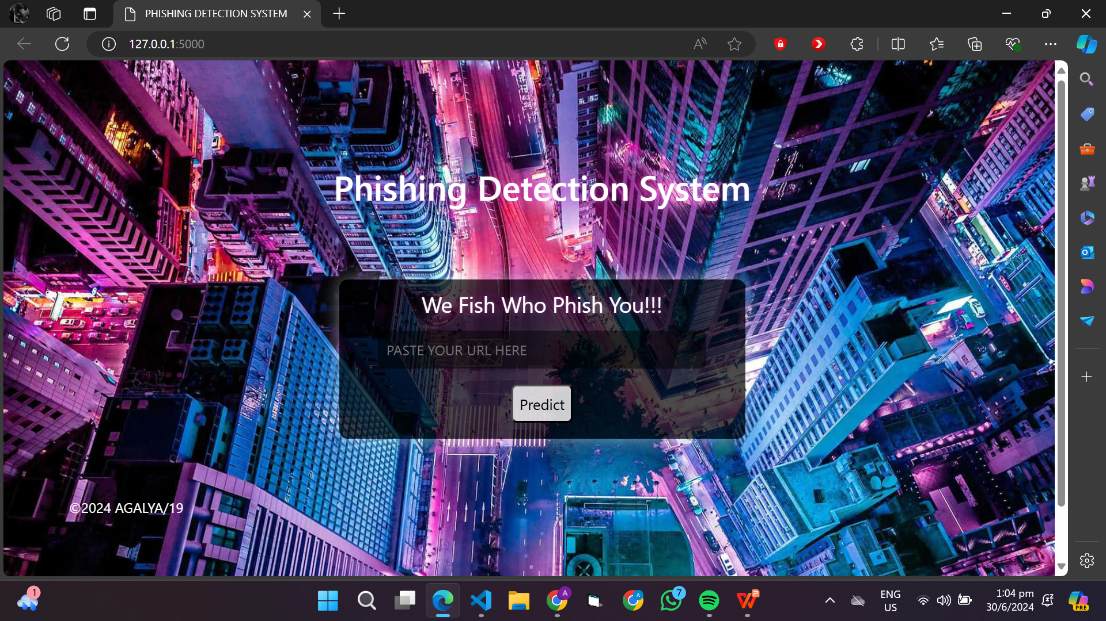
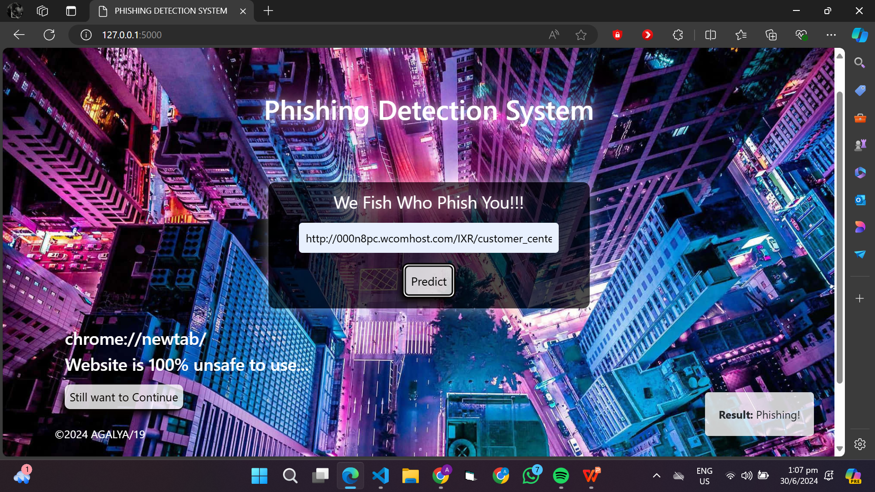

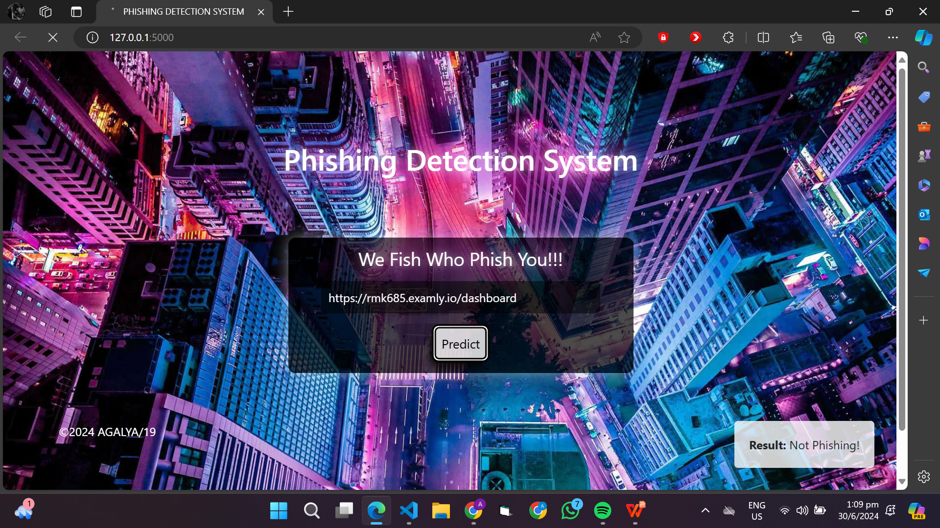

Slide 9
Project Link(GitHub, Google drive link)
https://github.com/Agalya1909/Edunet-Foundation.git

Slide 10
Conclusion
The proposed system demonstrates the effectiveness of machine learning-based approaches for phishing URL detection, outperforming traditional rule-based systems.
The system's modular architecture and hybrid approach enable robust and scalable detection of phishing URLs, even in the presence of novel and adaptive threats.
The system's real-time classification capabilities enable rapid response to emerging threats, reducing the risk of phishing attacks and associated financial losses.

Slide 11
Future scope
Future developments could include integrating the system with other security systems, such as firewalls and intrusion detection systems, to provide a more comprehensive security solution.
The system could be expanded to detect other types of cyber threats, such as malware and ransomware, by incorporating additional features and algorithms.
The system could be adapted for use in other domains, such as detecting phishing emails or fraudulent transactions, by modifying the feature extraction and machine learning components.
The system could be improved by incorporating new machine learning algorithms or techniques, such as deep learning or transfer learning, to further enhance detection accuracy and robustness.

Slide 12
References
List and cite relevant sources, research papers, and articles that were instrumental in developing the proposed solution. This could include academic papers on bike demand prediction, machine learning algorithms, and best practices in data preprocessing and model evaluation.

Slide 13
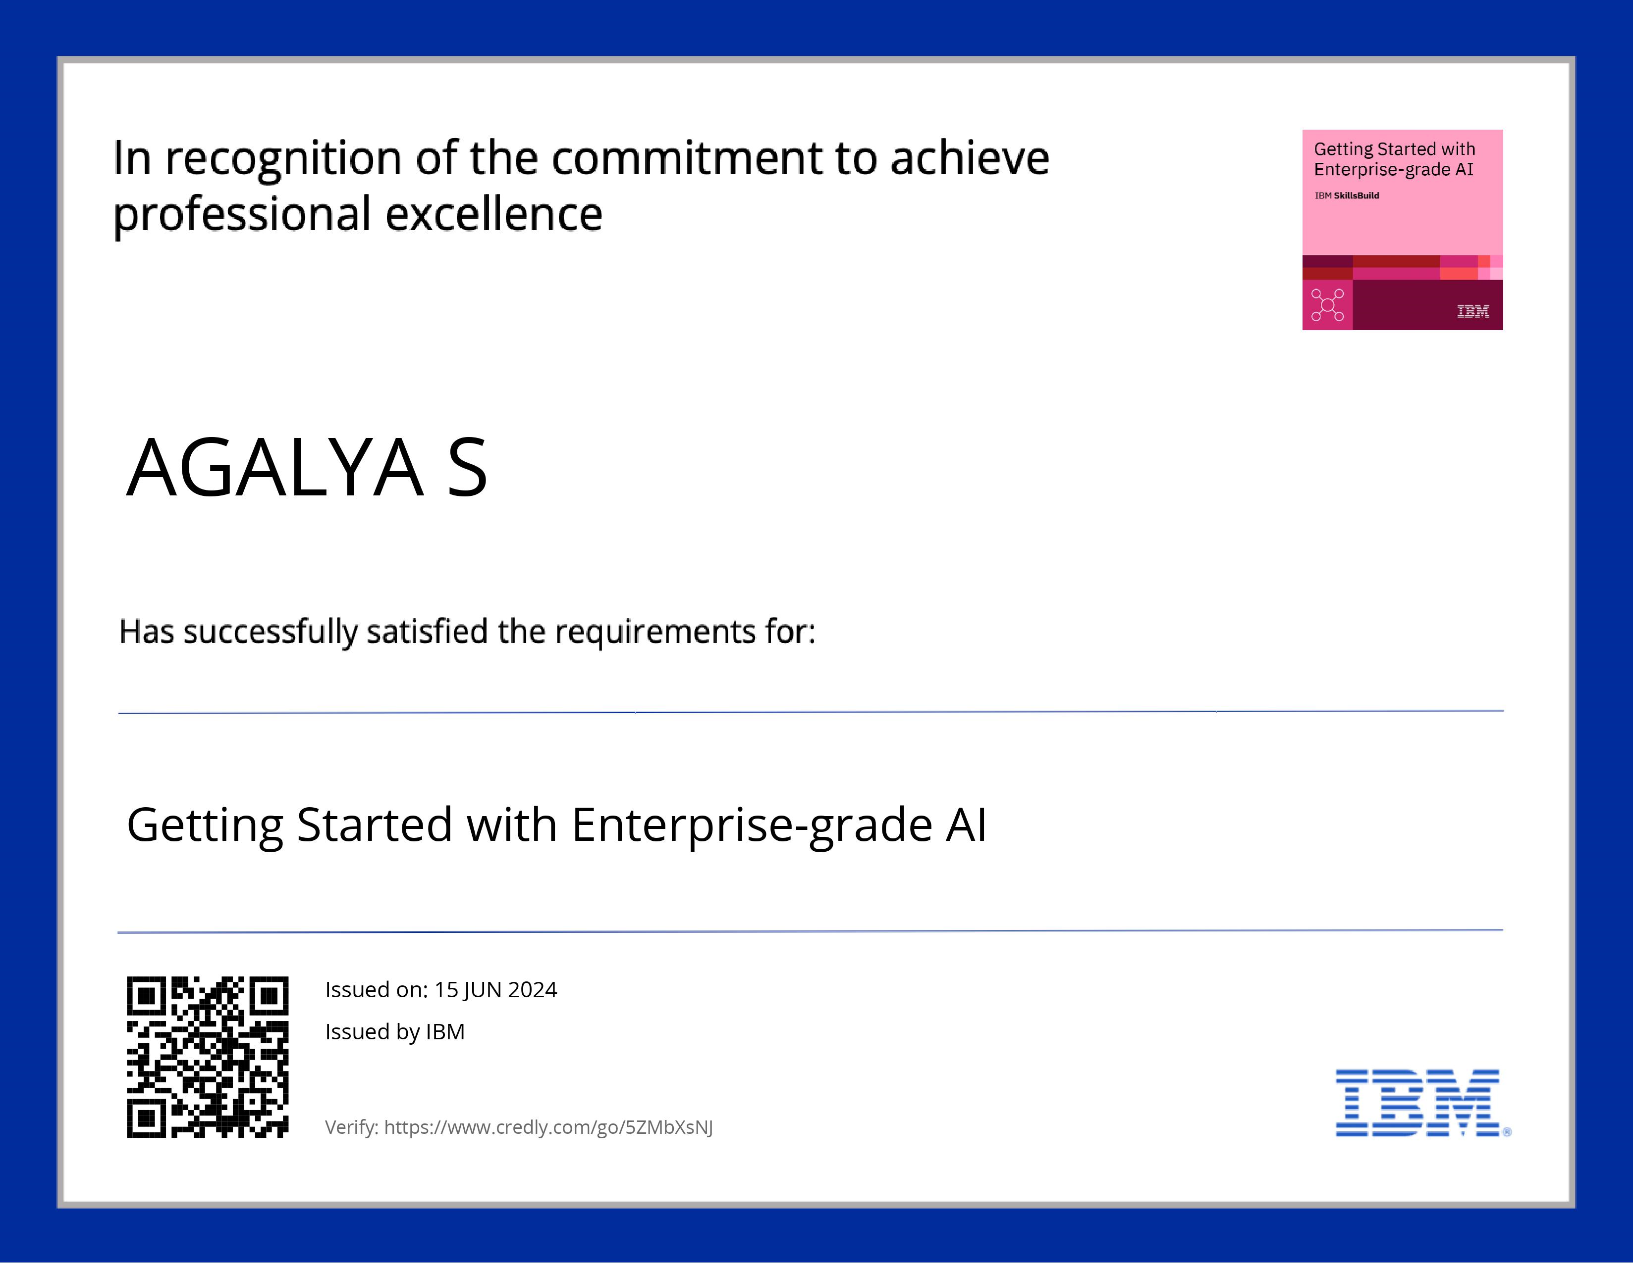
course certificate 1

Slide 14

course certificate 2

Slide 15
THANK YOU

